Slide 1



Enterprise IT Infrastructure, Security Architecture & Professional Ethics
A Comprehensive Case Study & Industrial Visit Analysis
TARGET ENTITY
ACADEMIC SESSION
Star Tech & Engineering Ltd (STEL)
Section: 65-M | Group: 10

Slide 2




Project Overview & Presentation Team
Academic & Industry Guidance
Student Presenters (Group 10)
COURSE INSTRUCTOR
Shafin Ahmed
Rimi Akter
ID: 232-15-184
Lecturer, Department of Computer Science & Engineering
Tanvir Kabir
ID: 232-15-753
INDUSTRY INTERVIEWER
Mr. Ariful Islam
Mynuddin Ahmed
Manager, Presales (Network & Security), STEL
ID: 232-15-179
Hasan Tarek
ID: 232-15-650

Slide 3

Presented By Shafin Ahmed (232-15-184)
Introduction & Company Overview
•
B2C & B2B: Retail tech leader with a focused Enterprise Division.
•
Core Focus: Network infrastructure, cybersecurity, and data centers.
•
Clients: Banks, corporate enterprises, and government bodies.
•
Tech Partners: Cisco, Fortinet, Palo Alto, F5, and Radware.

Slide 4






Presented By Shafin Ahmed (232-15-184)
Privacy & Data Collection Principles
Zero Trust (ZTNA)
Device Posture
Data Collection
Network Access Control
Two Factor Authentication
Updated Operating System
Analysis only high level data not deep level data.
Covered Questions:
How does STEL implement to protect client data privacy in enterprise networks?
What data is collected during tasks, and how to ensure privacy compliance?

Slide 5

Threat Mitigation & Remote Security
DDoS Attack Defense
Enterprise-grade appliances (Radware, F5) integrate AI-driven behavioral algorithms to filter high-volumetric attack traffic directly at the network perimeter.
SSL VPN Encryption
Secures remote workforce access using tools like Cisco AnyConnect, Palo Alto GlobalProtect, and FortiClient to eliminate Man-in-the-Middle (MitM) packet sniffing.

Slide 6
System Reliability & QA Testing
High Availability (HA)
Disaster Recovery (DR)
Quality Assurance (QA)
Core routers and perimeter firewalls are deployed in Active-Standby redundant pairs to execute instant sub-second failover during hardware failure.
Geographically isolated Data Center (DC) and Disaster Recovery (DR) sites maintain continuous business operations during regional physical disasters.
Network migrations and architecture upgrades are thoroughly staged in parallel environments before executing seamless live cutovers.

Slide 7

Intellectual Property
1) Direct Vendor Provisioning: STEL provides software only from official vendors.
2) Intellectual Property Protection: STEL respects copyrights,patents and trademarks.
3) Open Source Risks: Does not use crack or illegal software.
Question: How does Star Tech protect software licences and intellectual property?

Slide 8
Professional & Ethical Issues
Client Confidentiality: Keeps all clients info safe and private.
Controlled Access Support: Help clients through secure remote access and never save their password and personal info.
Ethical Presales: Engineers give honest advice and always recommended original licensed software instead of cracked software.
QUESTION: How does Star Tech handle copyright and licensing for open-source and licensed software?

Slide 9

Social Impact & AI Integration
AI Cyber Threat Landscape
Malicious actors leverage high-performance GPU clusters and automated AI algorithms to accelerate decryption attacks on traditional legacy VPN tunnels.
Post-Quantum Industry Shift
Modern network engineering is transitioning toward Post-Quantum Cryptography (PQC) standards to future-proof enterprise communications against quantum decryption risks.

Slide 10


Recommendations & Conclusion
Key Recommendations
Final Conclusion
•
Encourage enterprise clients to adopt Post-Quantum Cryptography (PQC) readiness frameworks.
The industrial visit to Star Tech & Engineering Ltd (STEL) provided valuable real-world insights into balancing Zero Trust security architecture, High Availability network reliability, and strict ethical and legal compliance within enterprise computing environments.
•
Enforce mandatory, automated device posture checks across all remote worker SSL VPN endpoints.
•
Integrate practical NDA, remote access, and ethical presales modules into academic CS curricula.

Slide 11



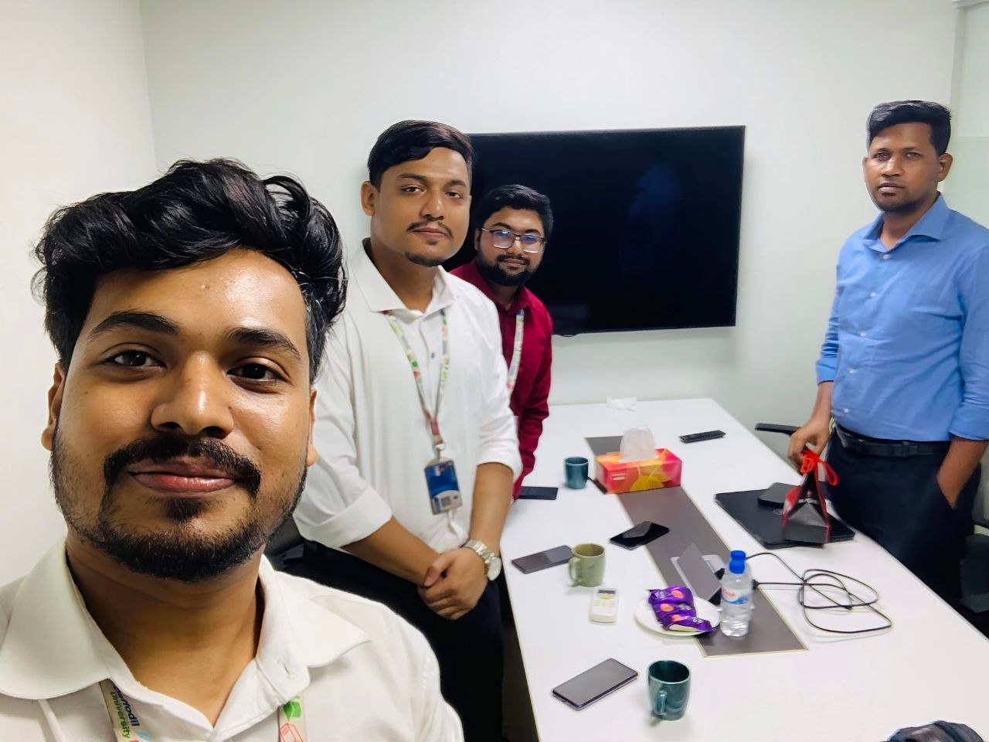
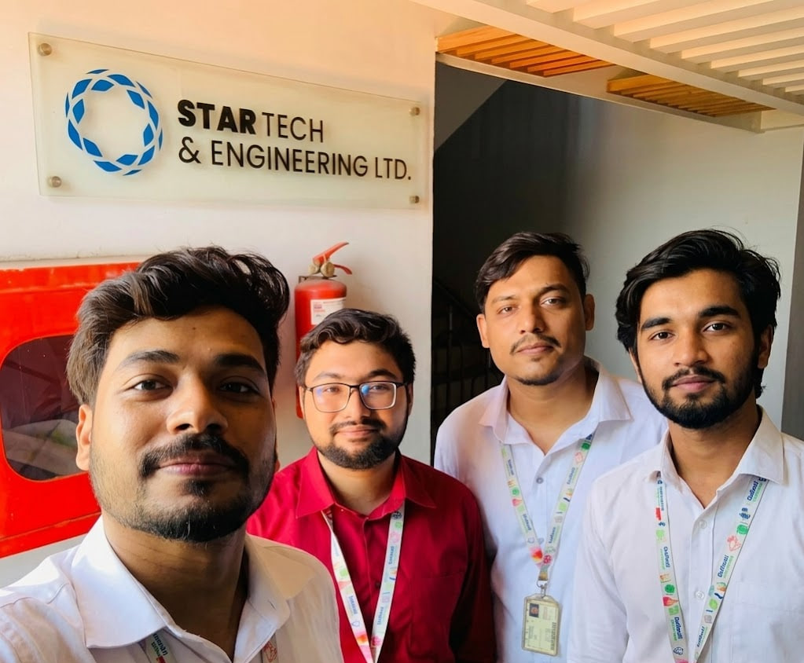
Industrial Visit & Interview Glimpses
Glimpses of Academic Industry Visit and Interview Session at Star Tech & Engineering Ltd
Presales & Technical Interview
Visit Wrap-Up & Group Photo
Interactive Q&A session with Mr. Ariful Islam, Manager (Presales Network & Security) at STEL.
Group 10 delegates gathered at the company entrance for the corporate walkthrough

Slide 12
Any Questions?
Thank you for your time and attention!

Slide 13




Image Sources
https://www.facebook.com/stel.com.bd/
Source: www.stel.com.bd
https://static.vecteezy.com/system/resources/previews/072/163/754/non_2x/cyber-security-and-digital-network-firewall-shield-with-futuristic-circle-on-blue-background-vector.jpg
Source: www.vecteezy.com
https://www.chitkara.edu.in/blogs/wp-content/uploads/2023/05/Big_Data_Analytics_in_Cloud_Computing.jpg
Source: www.chitkara.edu.in
https://cnsrisk.com/wp-content/uploads/2025/08/The-Growing-Impact-of-AI-and-Quantum-on-Cybersecurity.jpg
Source: cnsrisk.com

